Slide 1
SEM1 3.01 A - Market Planning
PE – Select target market appropriate for product/business to obtain the best return on marketing investment
PI – Describe the nature of target marketing in sport/event marketing

Slide 2

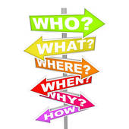
Terms
Market – includes the group of all potential customers who share common needs
Target market – group of very specific customers that a company desires to have as consumers
Mass marketing – single marketing plan to reach all consumers – Ex: bottled water
Marketing segments – groups of unique individuals that share common characteristics
Market segmentation – dividing the entire market into smaller groups that share common characteristics & to create a target market – niche market would be an example

Slide 3
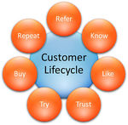

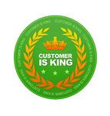
The importance of target markets to SEM & why is it increasing
Provides them with a group of potential or existing customers in which to communicate
About their good or service to match, understand & satisfy customer needs – (leads to customer retention too!)
Who is buying, what do they buy and why do they buy – the more you know the better your product can satisfy those specific needs

Slide 4


The importance of target markets to SEM & why is it increasing
Develop a specific, targeted marketing mix
Reflect differences in customer tastes & their needs
Increased sales & profits from each targeted market & more opportunities for growth
Make sure the customers you are targeting have the willingness and ability (disposable income) to purchase

Slide 5
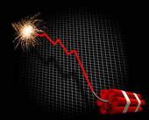
Describe advantages & disadvantages of using Market Segments
Advantages
Distinctive/Identifiable
Accessible/Actionable
Easy to get to
Measurable/Definable
Substantial
Large enough to make a difference
Stable
Will be around long enough for marketing to work
Disadvantages
Wrong market
Can’t reach them
No real data
Bad forecasts or information
Fads

Slide 6
Describe advantages & disadvantages of Mass Marketing
Advantages
Less confusion
To implement
To customers
Less promotional cost
Less work
Strategic thinking
Manual hours
Disadvantages
Single message may not reach enough customers
May not keep pace with new trends
Lost sales opportunities
Harder and more costly to gain a new customer than to retain an old one

Slide 7



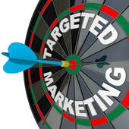
Trends to smaller market segments
1950’s - Mass Marketing
1960’s Market Segments
1970’s Niche Marketing
1980’s Mass Customization
1990’s Micro-Marketing
2000’s E-Marketing

Slide 8

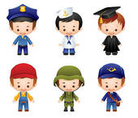


Demographic Market Segmentation
Age
Generation
Baby-boomers (‘46 – ’64)
X (‘65 – ’76)
Y (‘77 – ’93)
Z (‘94 – ’04) techies
Gender
Family size
Family life cycle
Income
Disposable & Discretionary
Occupation
Education
Ethnicity
Nationality
Religion
Social Class

Slide 9
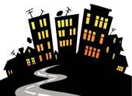
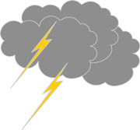
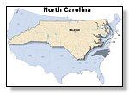
Geographic Market Segmentation
Region: by continent, country, state, city, neighborhood or street
Size of metropolitan area: segmented according to size of population
Population density: often classified as urban, suburban or rural
Climate: according to weather patterns common to certain geographic regions

Slide 10
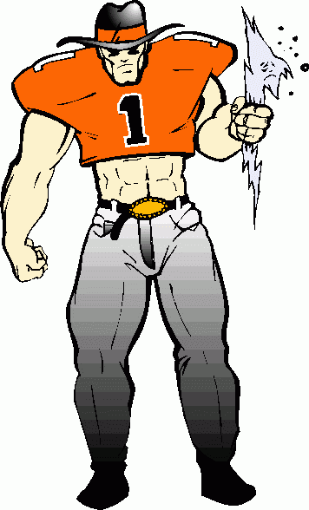
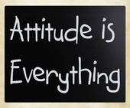
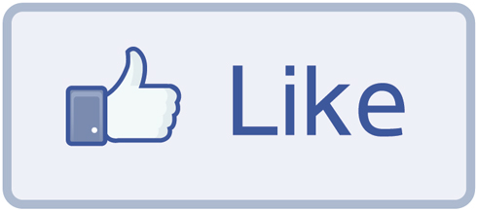
Psychographic Market Segmentation
Activities
Interests
Opinions
Attitudes
Values
Lifestyles
What a person likes to do

Slide 11


Behavioral Market Segmentation
Behavior towards a product
Benefits sought by the customer
Usage Rate – how often do they purchase?
Brand Loyalty – they expect something
User status – potential, first-time or regular
Readiness to buy – urgency
Occasions like holidays, birthdays & events that stimulate purchases

